Slide 1

Voice-Controlled Driving Robot with LLM Integration
CS232 – Artificial Intelligence (Project)
Presented By :
Team 2
Roll No:
U23CS014 : Naishadh Rana
U23CS022 : Nikhil Chhasiya
U23CS024 : Parth Gandhi
U23CS028 : Siddhartha Chatterjee
U23CS080 : Divyansh Vijay
April 2025

Slide 2
Introduction
Problem Statements:
People with physical impairments or situational constraints can have difficulty carrying out tasks like carrying items or accessing places.
In hospitals a lot of infections are caused due to direct exposure of patients, nurses and other staff members with each other, even with sterile surgery equipment.
Warehouse workers need to be trained and are often overworked.
Mapping of unknown territory has always been a strenuous job.

Slide 3
Introduction
Solution:
Users can say “follow me” or “fetch remote” making robots act as personal aides.
Simple Voice commands like “bring meds to Room 12” prevent human interactions in isolation and containment areas. It also reduces PPE (Personal Protective Equipment) use.
Voice-Guided Picking in warehouses, like “Pick item 42 from Aisle 5” accelerates order fulfillment with human minimal training.
Direct voice commands instead of controlling them with remotes let robots dynamically adapt to changing environment.

Slide 4
Objectives
Goal:
ESP32-powered mobile robot
Voice interface via Whisper (ASR) + BERT (NLP) + LLM for command interpretation
Multi-language support: English, Hindi, Gujarati
Objectives Achieved:
Voice recognition for commands in English. (Tried for other languages)
Mapped natural language commands to specific motor actions (forward, backward, left, right, stop)
Ensure real-time, accurate control and feedback

Slide 5
Assumptions
Voice Recognition: The robot's voice recognition system can accurately interpret commands in various acoustic environments.​
Stable Operating Conditions: presuming the robot will operate in environments with minimal obstacles and consistent lighting for optimal performance.​
User Familiarity: Assume users are trained to issue clear and concise voice commands to the robot.​

Slide 6
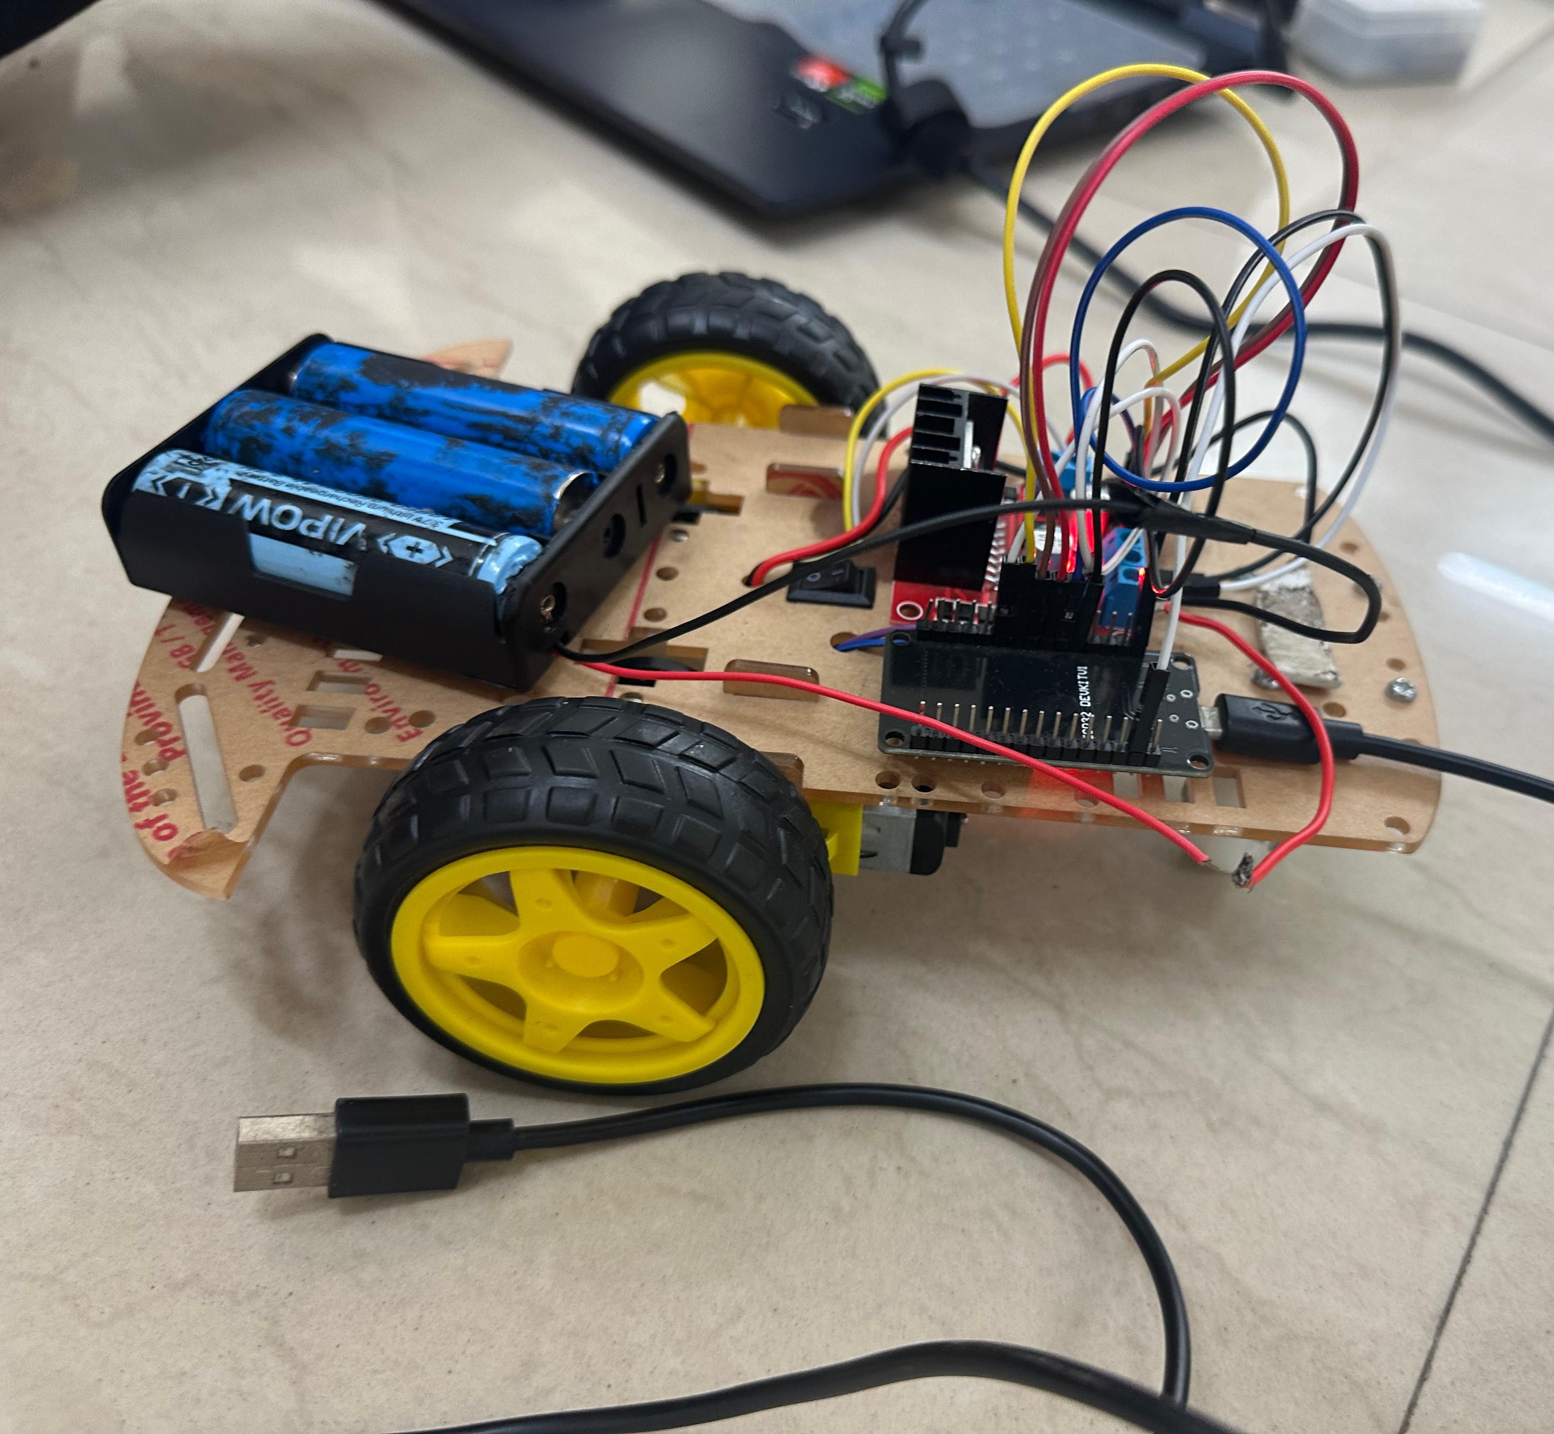
Hardware Requirements
ESP32
DC Motors
L298N motor driver
Chassis
Wheels
Power Supply (12V)

Slide 7
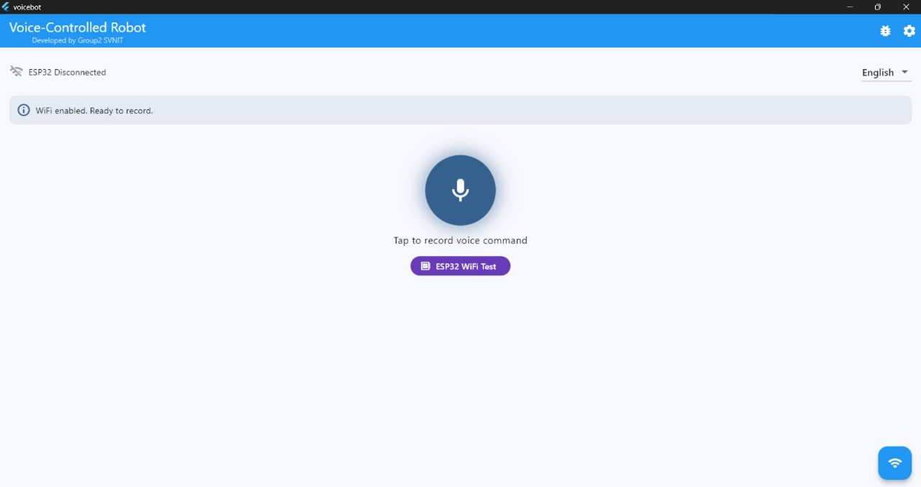
Tech Stack
Flutter/Dart
Pytorch
Embedded C (ESP32 Programming)

Slide 8
Agent Introduction
Input:
Voice Commands: User gives a direction based command in English.
Output:
Physical movement of the robot.
Agent Type:
Model Based Rational Agent

Slide 9
Methodology – PEAS Framework
Performance Measure:
Accuracy in recognizing and executing voice commands.
Minimizing response time
Environment:
Closed Indoor Environment
Actuators:
DC motors
Sensors:
Primary sensory input via phone microphone (mobile application)

Slide 10
Methodology - Algorithm
User inputs command on the mobile application.
The given input is converted to text
Text sent to LLM for processing and command interpretation.
LLM identifies the command and translates to robot control signals.
Control signals sent to ESP32
ESP32 executes appropriate motor control functions

Slide 11
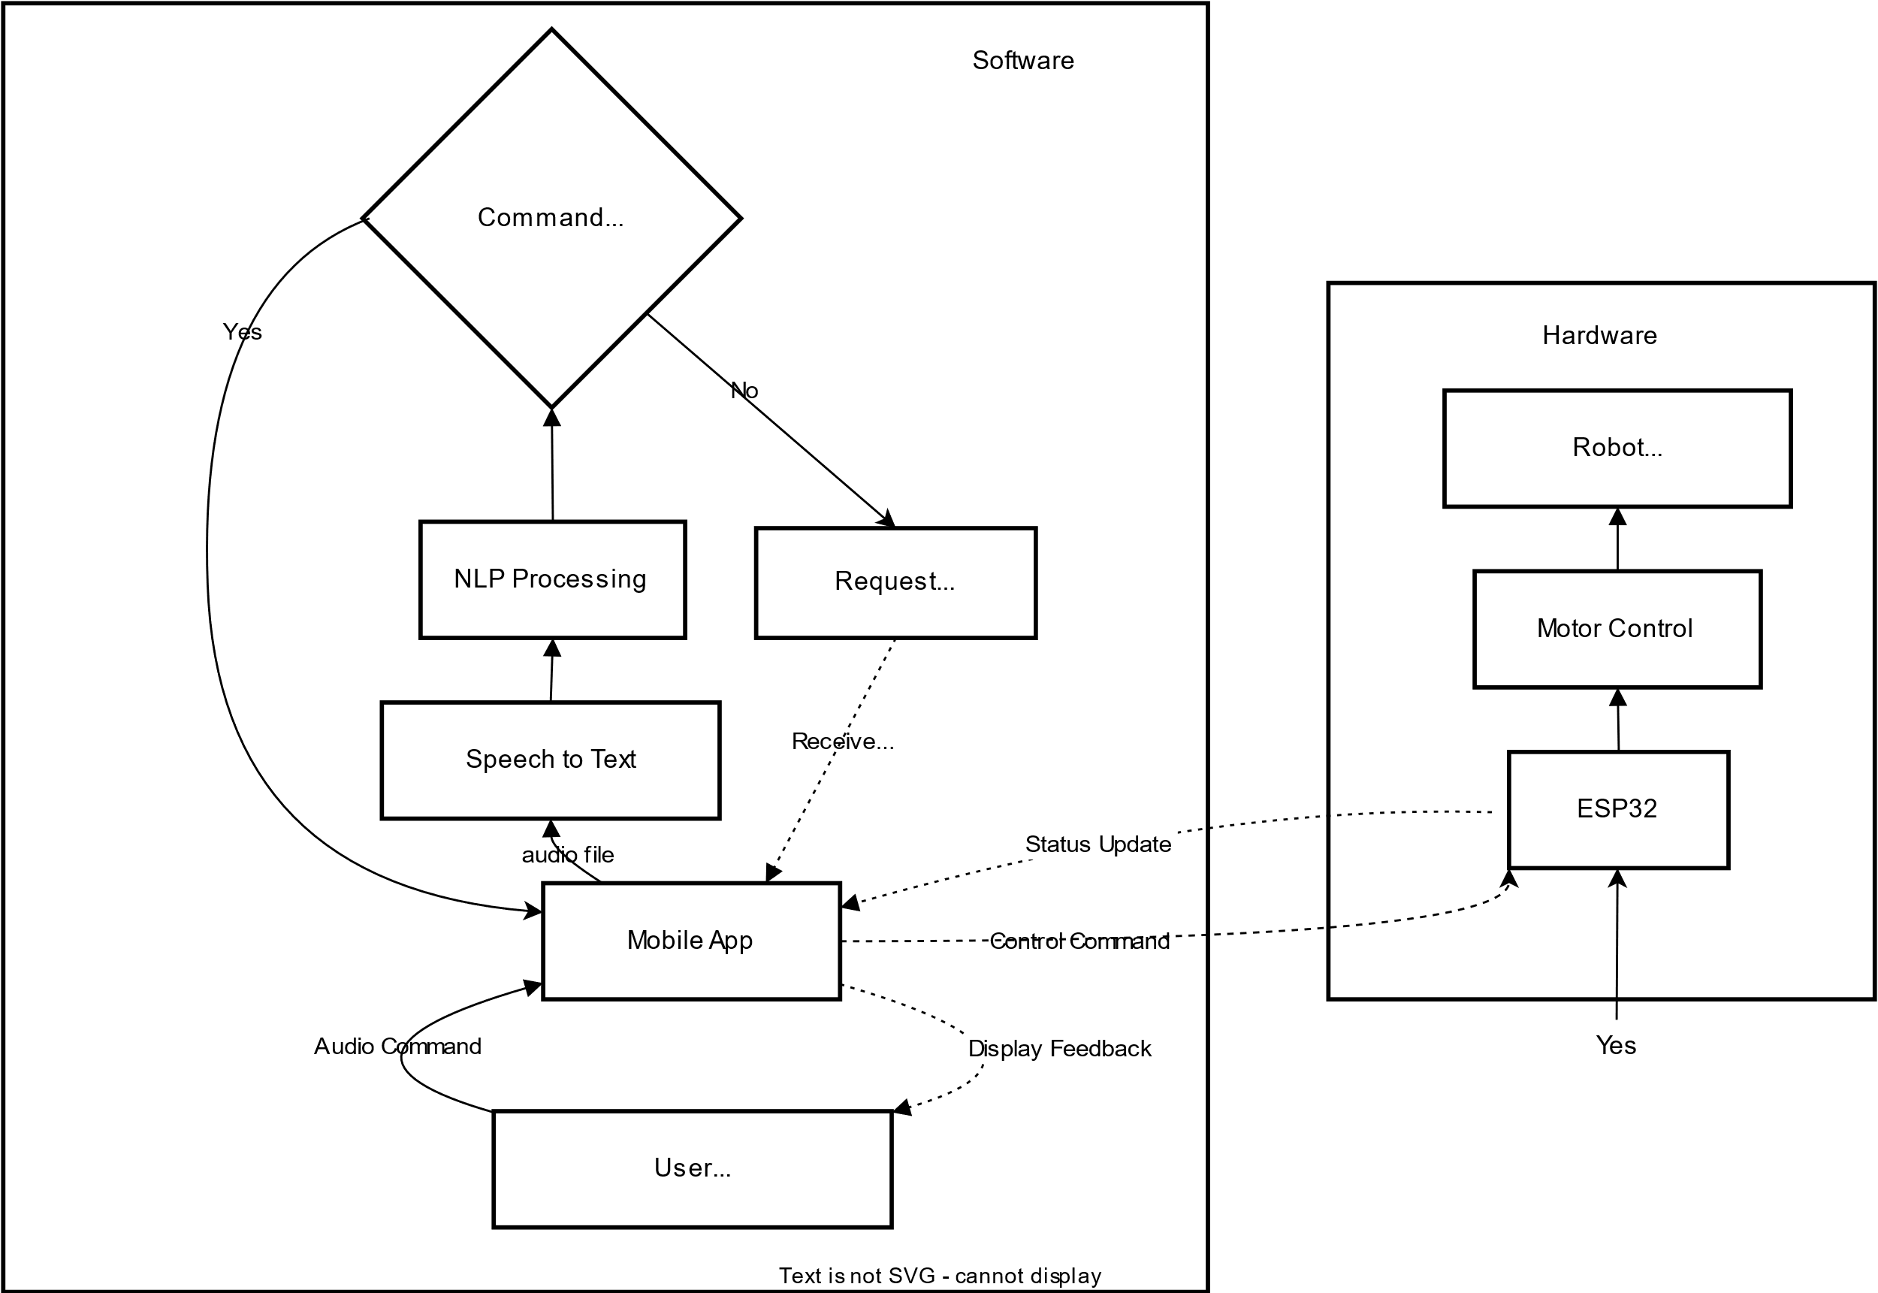
Flow of Working

Slide 12
AI Module / Chapter Used
Module 2 (To identify problem statement, understanding environment, deciding PEAS)
Module 5 (Knowledge representation & planning [LLM routing])

Slide 13
Whisper Functionality
Converts spoken words into machine-readable input for action execution.​
Audio Capture: Whisper records your voice input and splits it into 30-second segments.
Preprocessing: The audio is normalized and converted into a log-Mel spectrogram (a time-frequency representation).
Model Input: This spectrogram is fed into a Transformer-based neural network trained on multilingual speech data.
Speech Recognition: The model predicts the spoken words, handling various accents, noise, and speech patterns.
Language Detection & Translation: It detects the spoken language and, if needed, translates it into English.
Text Output: Finally, it generates English text tokens as accurate transcriptions of the original speech.

Slide 14
DistilBERT Functionality
Extracts action (e.g., “go forward”), parameters (speed, distance)
1. Input Tokenization: The input sentence is first broken into smaller units (tokens) using a tokenizer (like WordPiece), and each token is mapped to a unique ID.
2. Embedding Layer: These token IDs are converted into dense vector embeddings, capturing semantic and positional information.
3. Transformer Layers: The embeddings are passed through multiple layers of a smaller, distilled Transformer, which mimics BERT’s behavior but with fewer parameters and faster computation.
4. Contextual Understanding: Each token’s representation is updated by attending to all other tokens using self-attention, allowing the model to understand context.
5. Output Generation: The final hidden states can be used for tasks like classification, question answering, or feature extraction, depending on the application.
6. Efficiency: DistilBERT retains about 97% of BERT’s performance while being 40% smaller and 60% faster.

Slide 15
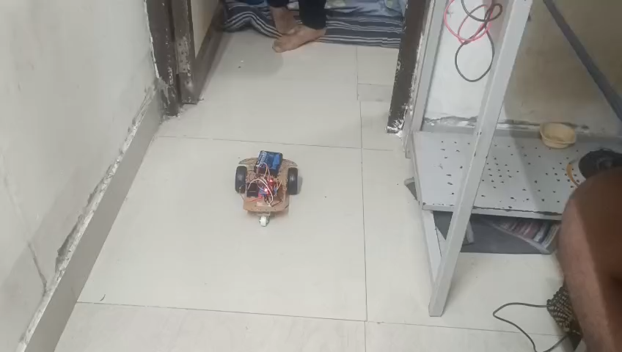
Working Video

Slide 16
Our Learnings
Siddhartha Chatterjee:
1. Had the experience of app development using Flutter
2. Learnt using different packages for different purposes like recording of audio and api calls (and Bluetooth connection, unused)
Parth Gandhi
1. Learnt how to use Whisper(ASR model)
2. Learnt basic use of Distil-BERT (NLP model) for command extraction.
Nikhil Chhasiya
1. Fine-tuning
2. Deployed and Set up Models on Hugging face
3. Learnt a synthetic Dataset using GANs.
4. Wiring and circuit knowledge
5. Bert-base-multilingual-cased

Slide 17
Our Learnings
Naishadh
1. Ideation and critical thinking
2. Arduino Coding
3. Hardware configurating and integration
4. Always keep backup hardware (motor drivers, cell holders etc)
5. ESP Programming
Divyansh
1. ESP Programming
2. Text Classification using BERT
3. Llama (unused)
4. Dataset cleaning
5. Learnt Flutter

Slide 18
Issues We faced
Choosing model
How to minimize latency
Not able to use Bluetooth module (hc-05) due to which we got a big setback on hardware part
Integrating all different areas together
Creating database for finetuning

Slide 19
References
ESP32 Datasheet, Espressif Systems.
Vaswani, A. et al. (2017). BERT: Pre-training of Deep Bidirectional Transformers.
https://github.com/chatterjee-sid/voicebot (Our project app repo)
https://docs.flutter.dev/

Slide 20
THANK YOU

